Slide 1
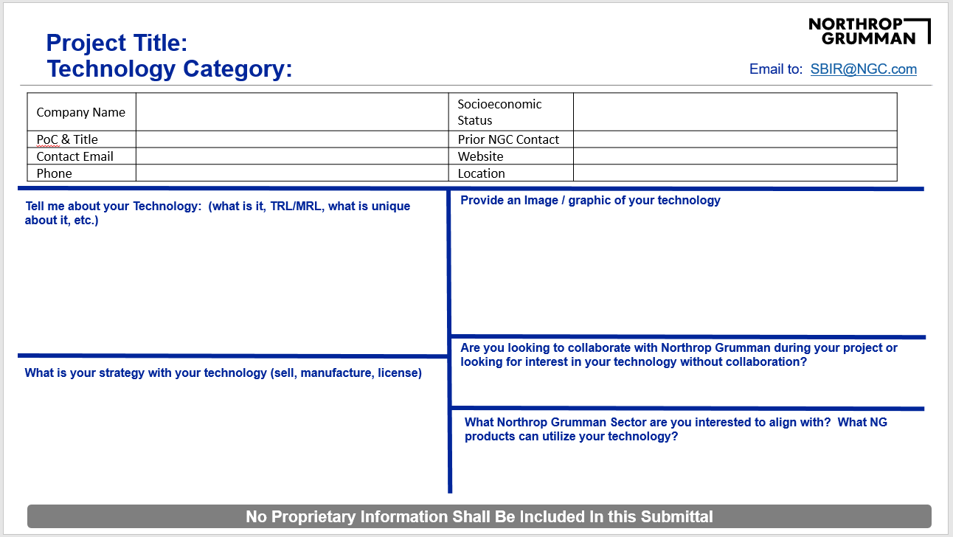
How to Engage with the Northrop Grumman SBIR Team
#1 – Fill out the Northrop Grumman Technology Summary Template (access via website)
#2 – Email your completed form to SBIR@NGC.com
#3 – Northrop Grumman SBIR Team will Review & Engage
Northrop Grumman Wants to Work with You

Slide 2
Project Title: Technology Category:
Email to: SBIR@NGC.com
Company Name |  | Socioeconomic Status
PoC & Title |  | Prior NGC Contact
Contact Email |  | Website
Phone |  | Location
Tell me about your Technology: (what is it, TRL/MRL, what is unique about it, etc.)
Provide an Image / graphic of your technology
Are you looking to collaborate with Northrop Grumman during your project or looking for interest in your technology without collaboration?
What is your strategy with your technology (sell, manufacture, license)
What Northrop Grumman Sector are you interested to align with? What NG products can utilize your technology?
No Proprietary Information Shall Be Included In this Submittal

